Slide 1

RETAIL INSIGHTS FROM SUPERSTORE DATA
NARENDRAN S P

Slide 2

PROBLEM STATEMENT
The dataset analysis will focus on identifying key performance indicators across regions, customer segments, product categories, and states. We'll calculate total sales and profit for each region to highlight the most lucrative areas. Additionally, we’ll determine which customer segment has the highest number of sales and which product category is the most popular. The state with the highest total sales and the state with the highest profit will be analyzed to inform targeted strategies. Lastly, the top 10 most profitable products and the category with the highest profit will be identified to guide inventory and marketing efforts.

Slide 3
PROJECT DESCRIPTION
The goal of this project is to perform data analysis on the superstore sales data to uncover insights into sales performance, customer behavior, and profitability. The analysis will focus on identifying patterns and trends in different regions, customer segments, and product categories -Total sales and profit by Region -Customer segment with highest no of sales -Which Category has the highest no of sales -Which state has the highest no of sales -Which state has the highest profit in sales -Top 10 most Profitable products -Which category has high profit

Slide 4

WHO ARE THE END USERS?
CEO
Manager
Various departments like SALES,INVENTORY
Customers

Slide 5

TECHNOLOGY USED
VS Code
Python(Numpy,Pandas,Matplotlib,Seaborn)

Slide 6
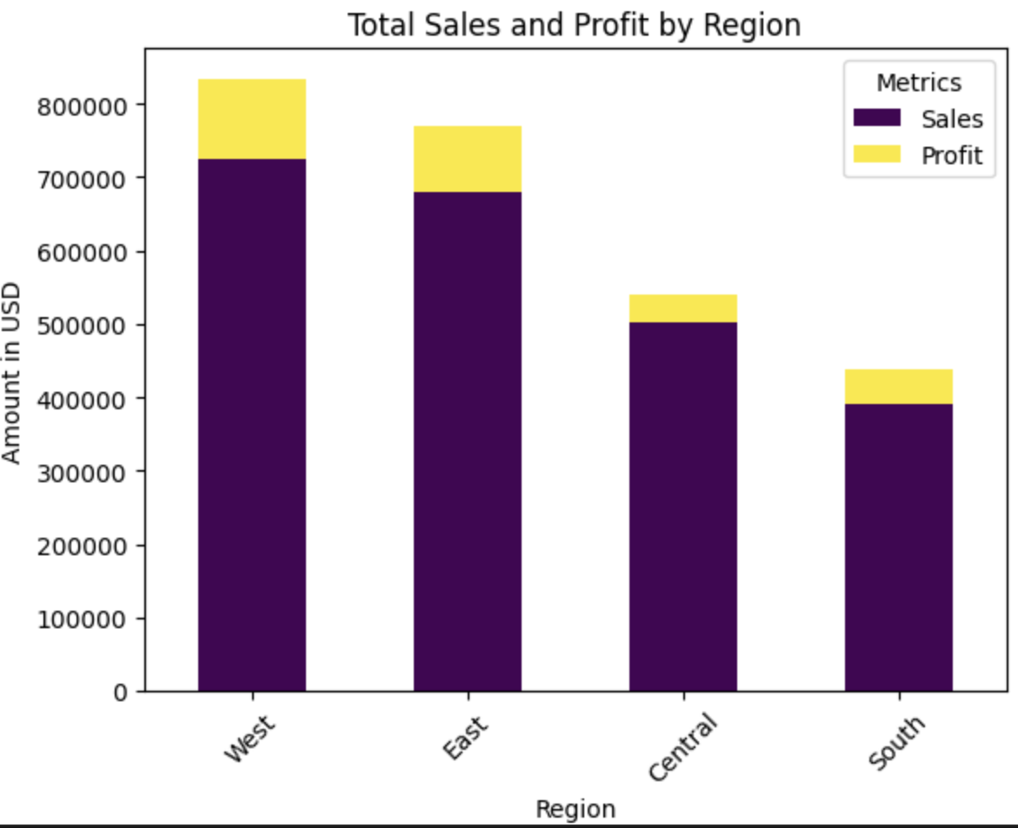
RESULTS
1.Which Region has the highest no of sales and profit
ANS:WEST
Demo Link

Slide 7
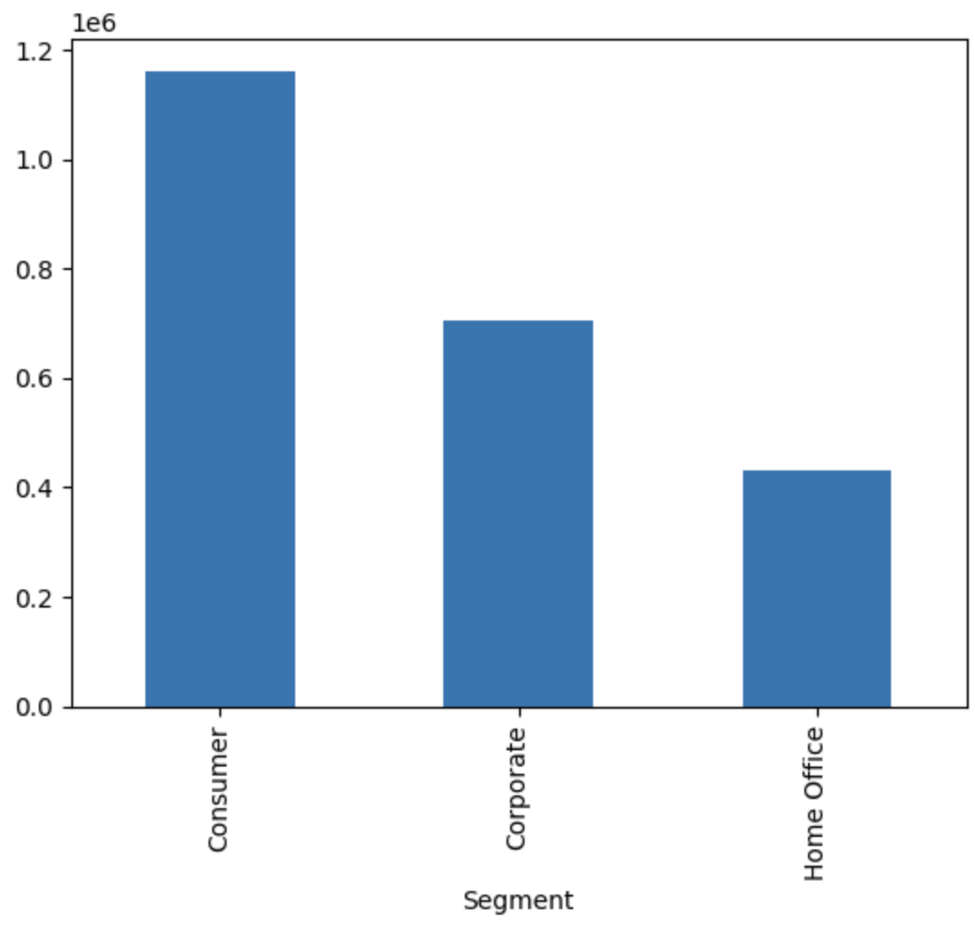
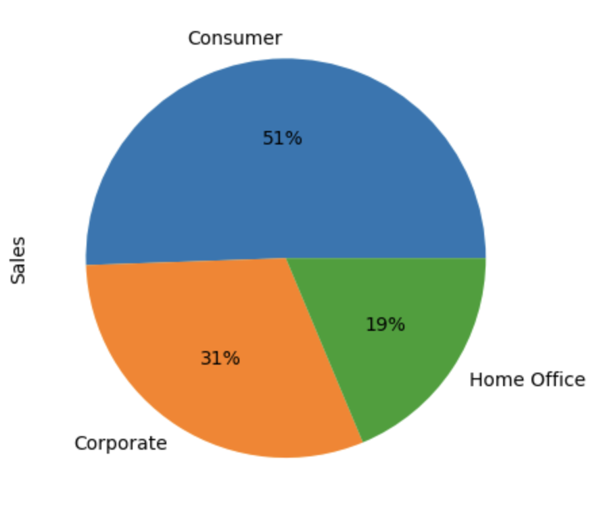
2.Customer segment with highest no of sales
ANS:Consumer

Slide 8
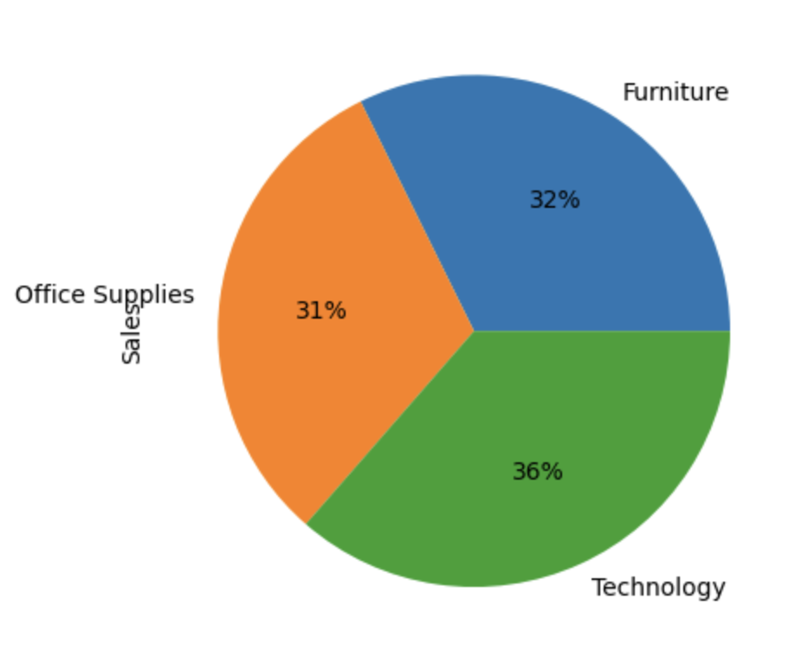
3.Which Category has the highest no of sales
ANS:Technology

Slide 9
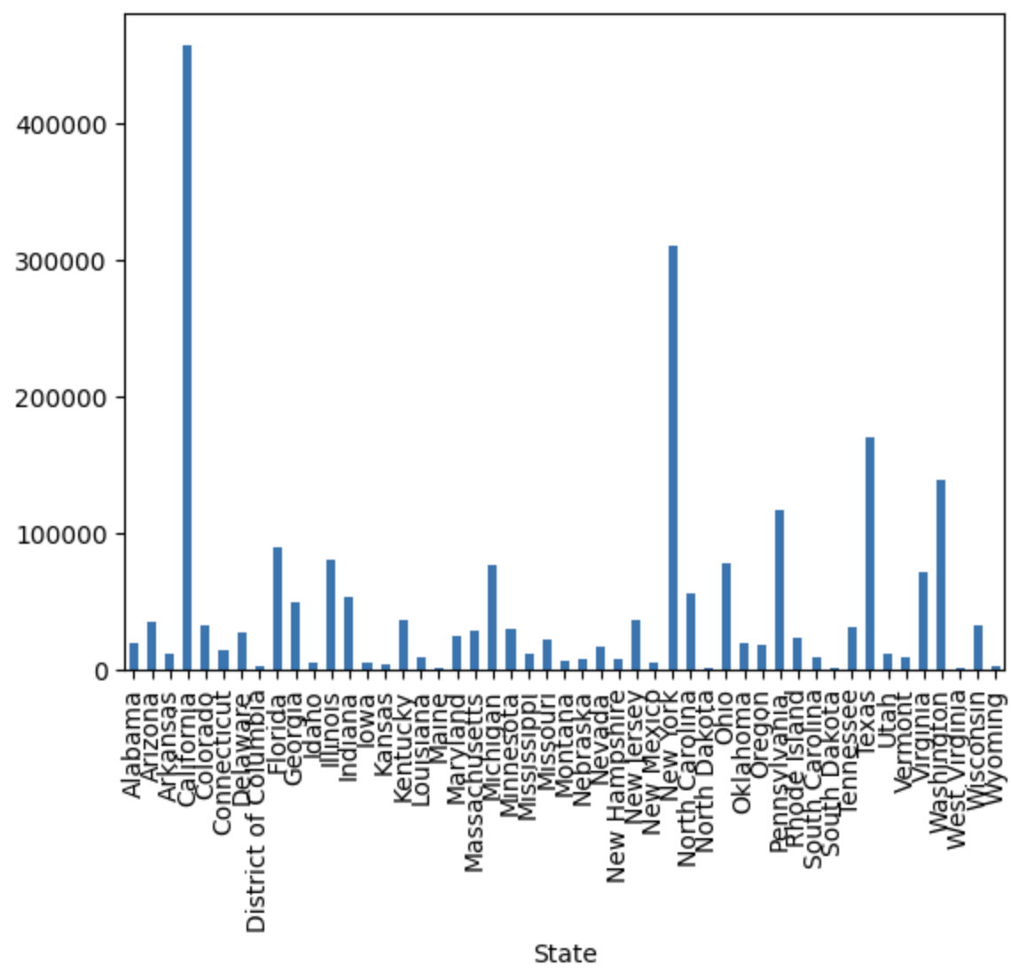
4.Which state has the highest no of sales
ANS:New York

Slide 10
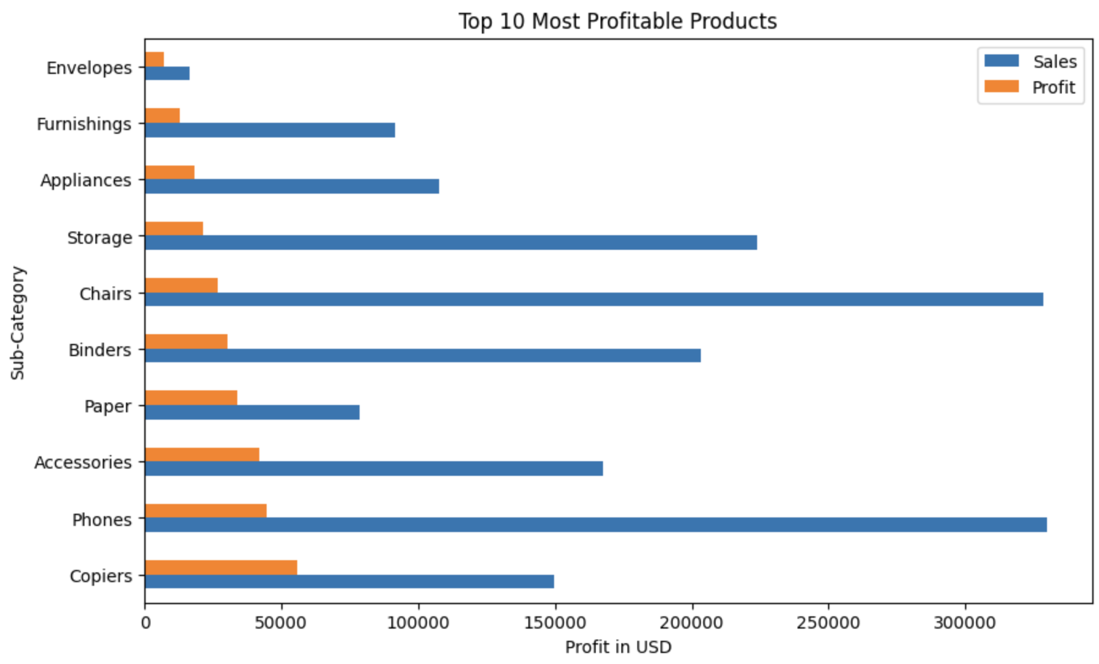
5.Top 10 Most Profitable Products

Slide 11
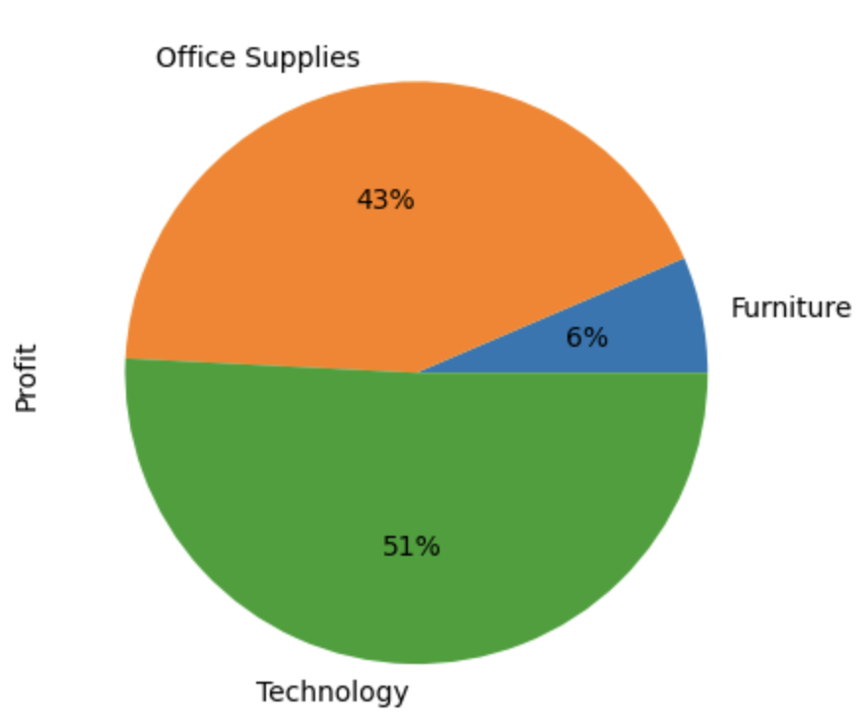
6.Which category has high profit
ANS:Office Supplies

Slide 12
THANKYOU
.
.
NARENDRAN S P
AICTE_VOIS_Internshp APPLY_172665201466ea9e6e01875

